Slide 1

Used Car Market in the U.S.
We are the Fifth Group!
[GO GO GO!!!!]
Andy, Ruihong Sun
Annie, Ziyuan Feng
Jack, Jieran Geng
Frank, Yifan Hu
Notes:
Para.1

Slide 2

Project Introduction
Introduce used car market in US to buyers.
Help users buy suitable cars.
Help different types of users buy their own cars according to the analysis of big data.
Notes:
Para.1

Slide 3

Overview on The Used Car Market in the U.S. Nationwide
In the sample, we have eight factors that may affect the users’ preferences
Can also display the situation of used car market in the U.S.
Condition
Paint color
Cylinders
Fuel
Manufacturer
Title status
Type
State
Notes:
Para.2

Slide 4

Analysis
Heat map
California
New York
3D Plot
California
New York
Data Resource: Kaggle
Notes:
Para.3, 4

Slide 5

Buyer Research
What type of car owner the buyer belongs to?
Notes:
Para. 5 green chart图在后面 然后assume three type在图后面一张

Slide 6
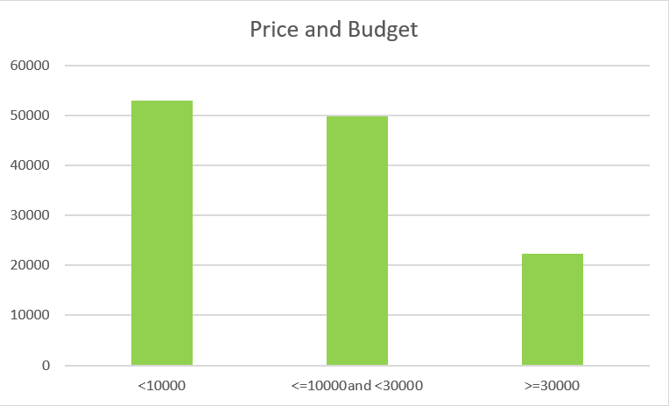
Notes:
Para. 5

Slide 7
Buyer Research
What type of car owner the buyer belongs to?
Assume three types of users in general based on their budgets.
Notes:
Para .5

Slide 8
Three types of user
First type-sufficient budget (>$30000)
Any kinds of models
Second type-relative sufficient budget ($10000~$30000)
Third type-insufficient budget (<$10000)
Condition of car is guaranteened
Premium models
Availability of cars is uneven
Choices of cars are limited
Notes:
Para. 6, 7, 8
这是一张图 然后后面也有三张是把first, second, third三个type分在三张ppt上（10， 11，12）了 你看看你比较喜欢哪个方式或者一起 不需要的删了就行

Slide 9

Car Finder
Car Finder (Based on users' budgets) From Colab
https://colab.research.google.com/drive/1U5R215KuiS8Imv4heGTSQk5qMqK1OpNT?usp=sharing#scrollTo=mw45wWd2vjCk
Notes:
Para.9

Slide 10

Conclusion
Rational car buyers think before buying
The domestic used car market in the U.S (based on sold car sample from Kaggle)
The relationship among Odometers, Manufacturing Date, and price in specific state based on the heat map and 3D plots
Different kinds of buyers based on their budgets
Show buyers how many cars they can choose in our sample through the help of our finders and prove the analysis
Notes:
Para. 10 感觉可以把之前总结的在这边再口头提一下

Slide 11

Thank you!

Slide 13
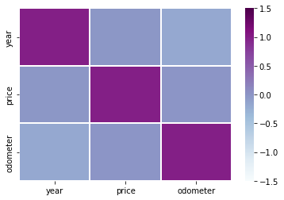
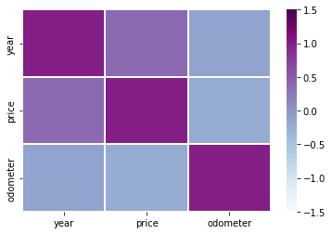
California | year | price | odometer
year | 1.000000 | -0.008111 | -0.176986
price | -0.008111 | 1.000000 | 0.001823
odometer | -0.176986 | 0.001823 | 1.000000
New York | year | price | odometer
year | 1.000000 | 0.378053 | -0.131839
price | 0.378053 | 1.000000 | -0.208791
odometer | -0.131839 | -0.208791 | 1.000000
Notes:
按图片返回 analysis slide

Slide 14
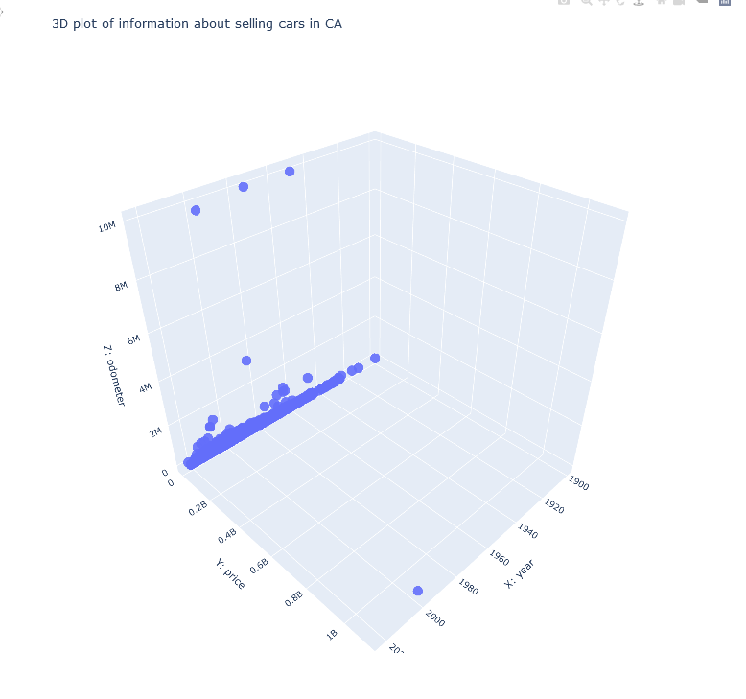
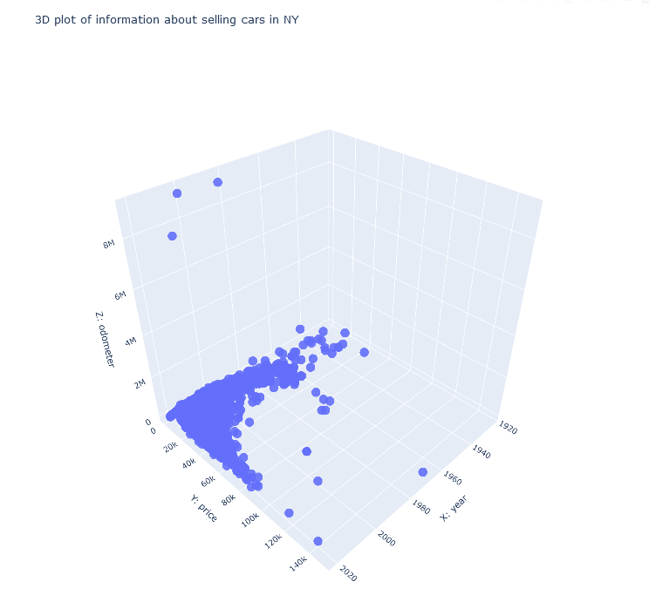
California
New York
Notes:
按图片返回analysis slide

Slide 15
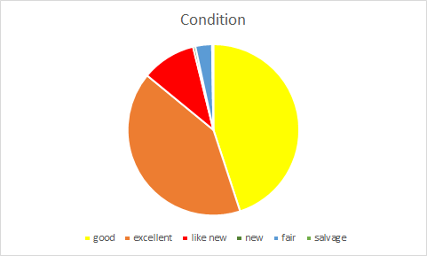
Notes:
接下来的图都是slide 3上对应的 均按图片返回slide 3

Slide 16
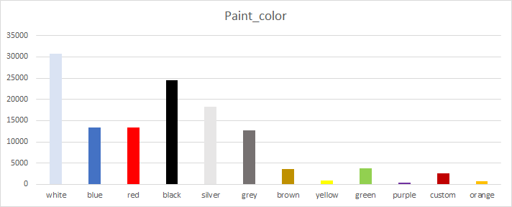

Slide 17
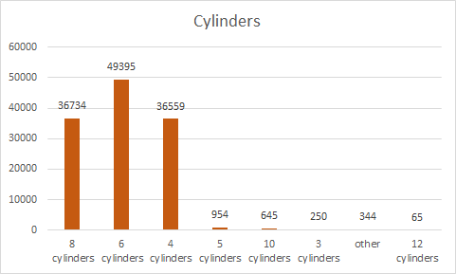

Slide 18
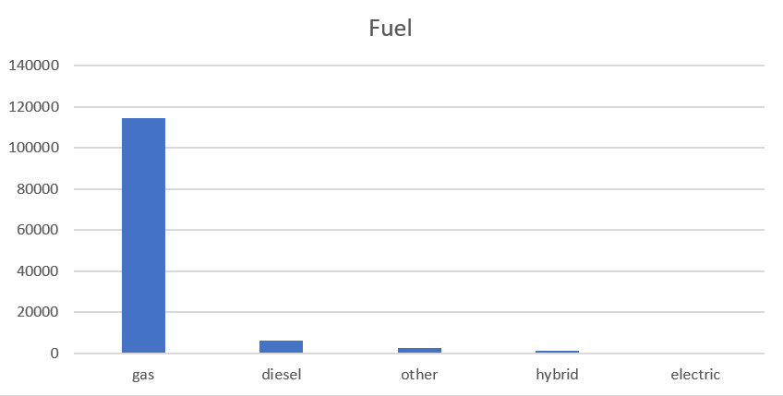

Slide 19
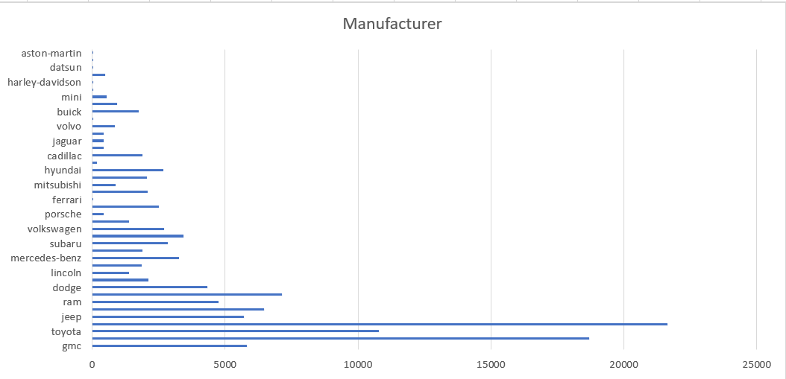

Slide 20
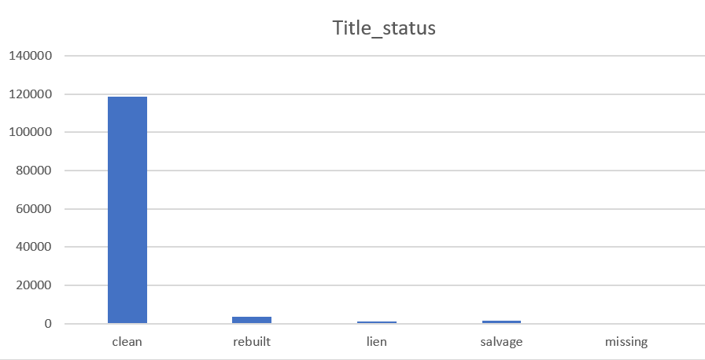

Slide 21
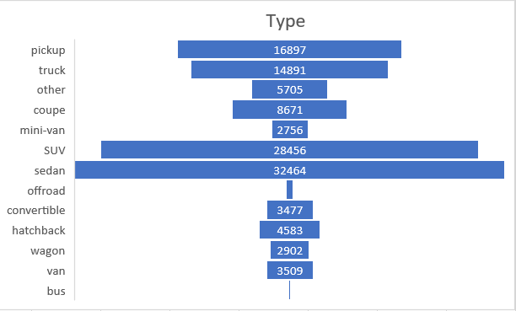

Slide 22
